Slide 1
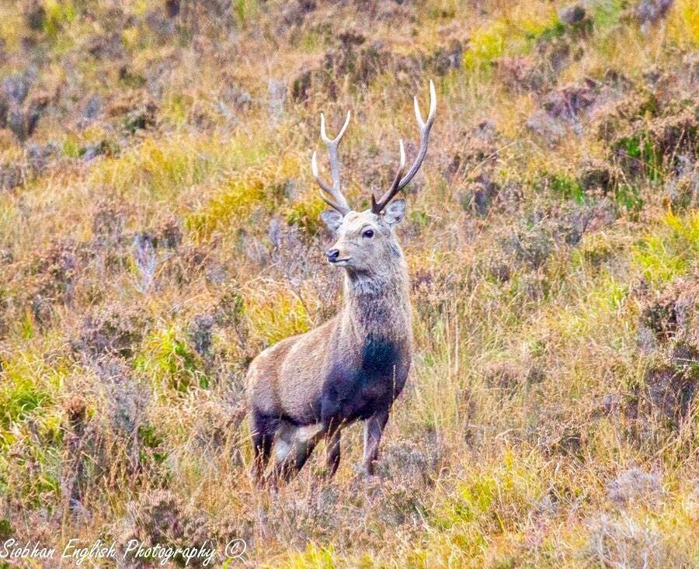
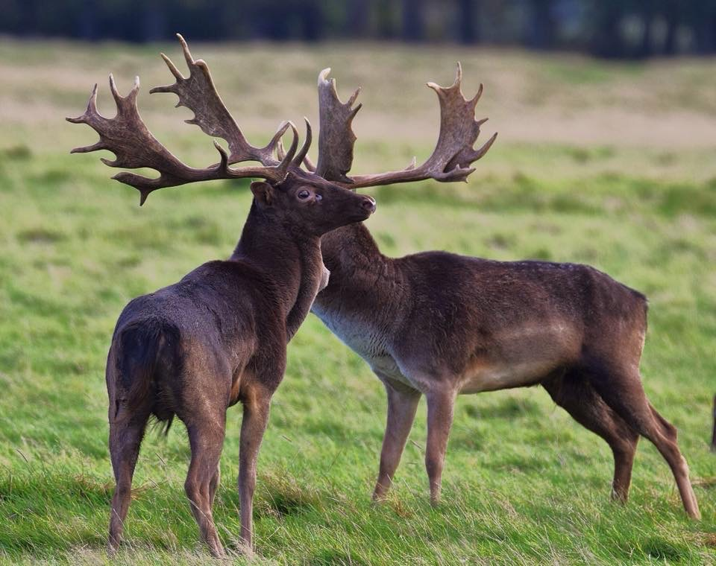

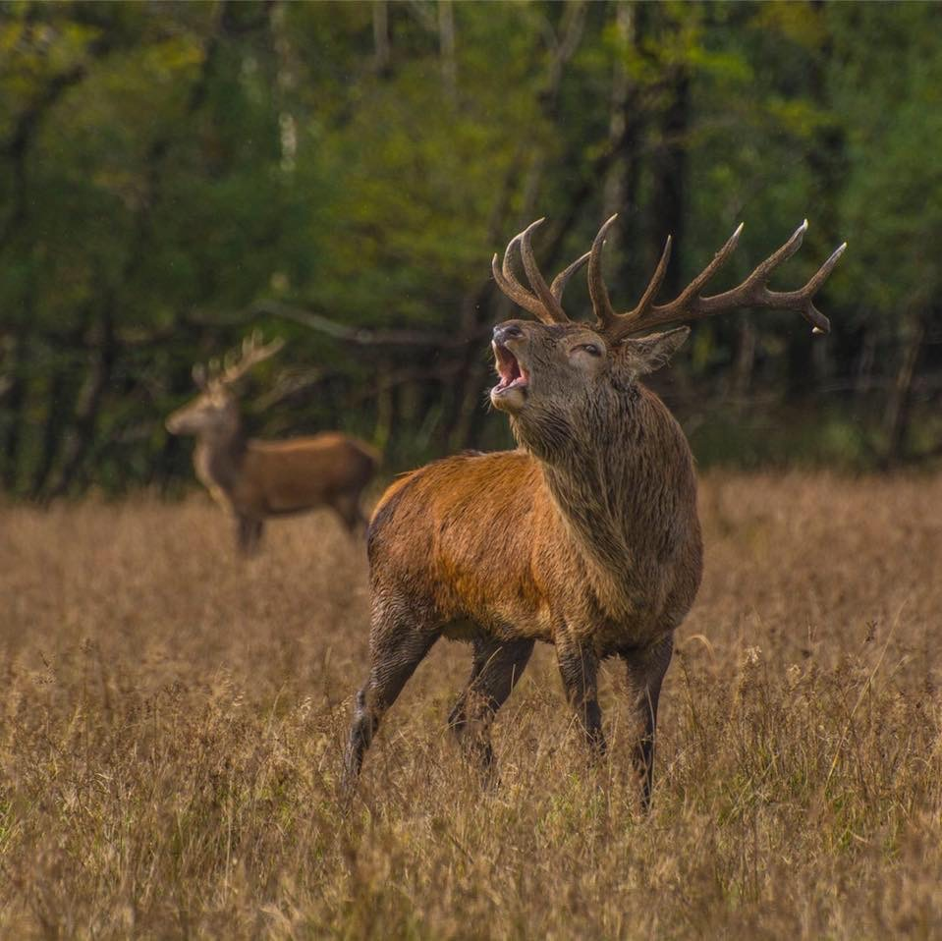

Facts about wild deer for the Junior Education Cycle with the Irish Deer Commission!

Slide 2
Ireland has three species of deer.
Deer are Ireland’s largest land mammal.
Deer can be found in every county in Ireland

Slide 3


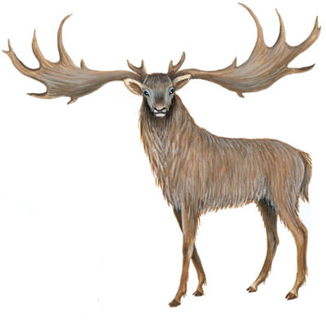
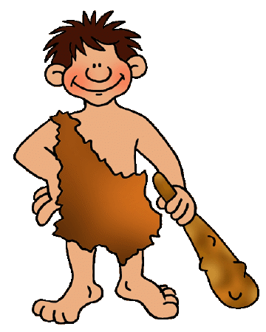
The tallest deer that ever lived
was the Giant Irish Deer

Slide 4
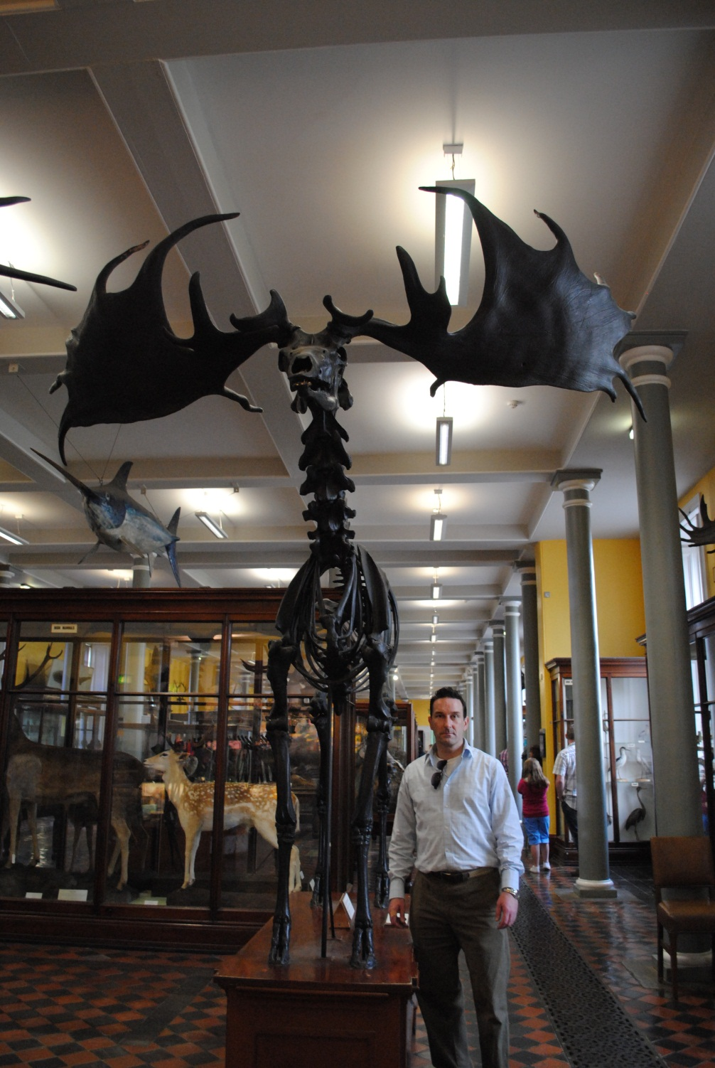
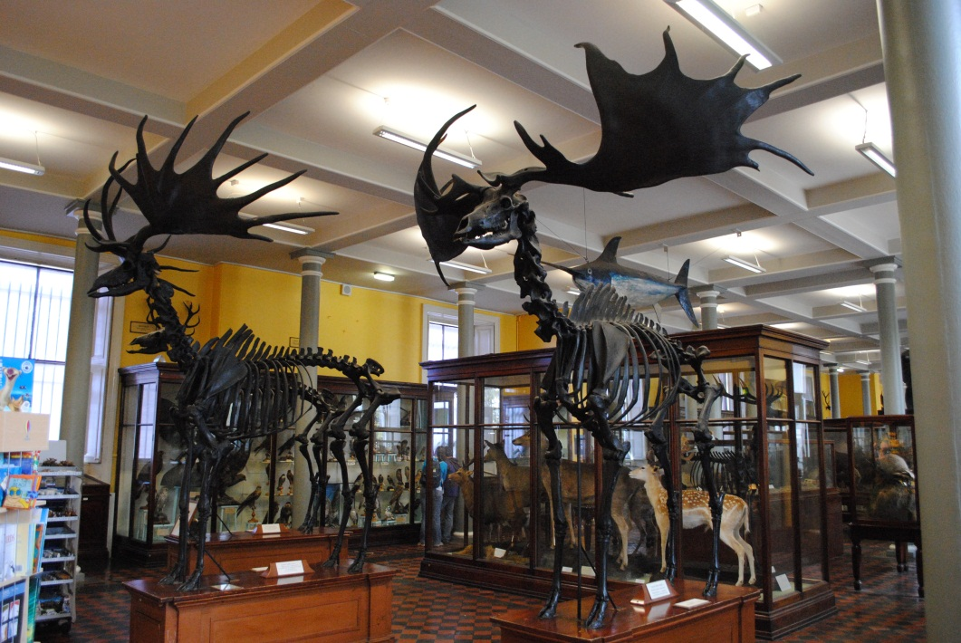
They became extinct about
10,000 years ago.
However……..

Slide 5
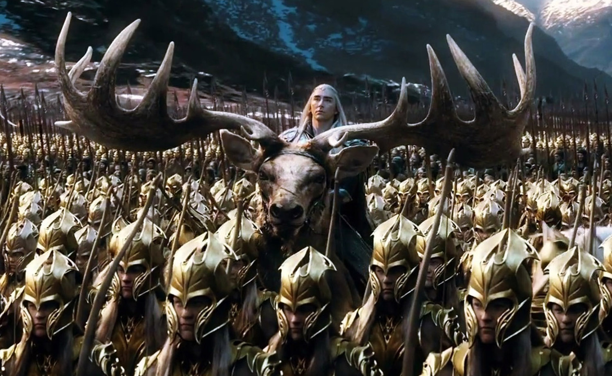
Megaloceros giganteus hibernicus
made an appearance in the hOBBIT.

Slide 6
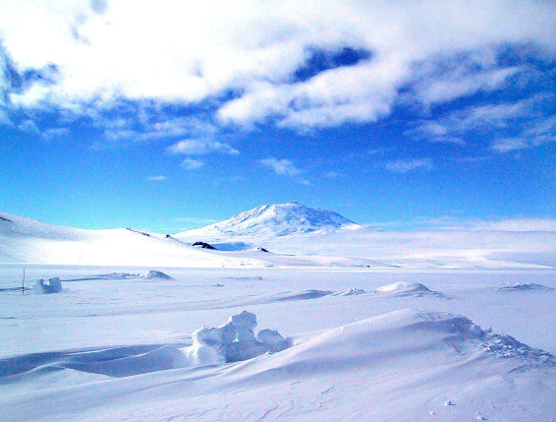
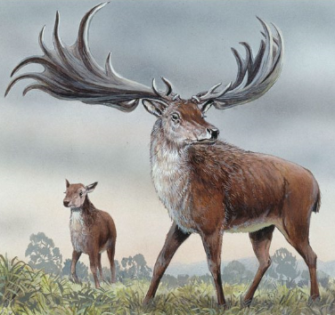
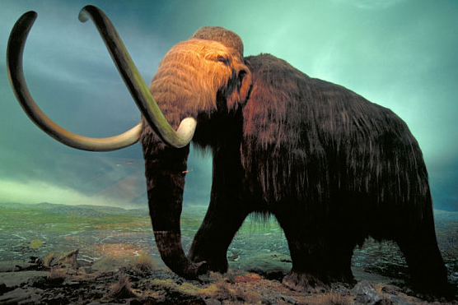
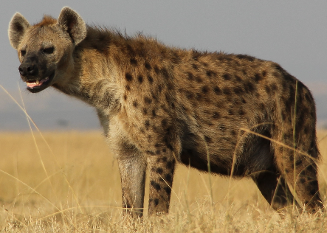
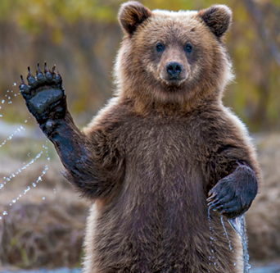
The Hyena
The Ice Age
The Giant Irish Deer
The Woolly Mammoth
The Bear
and the Reindeer
all became extinct in Ireland.

Slide 7
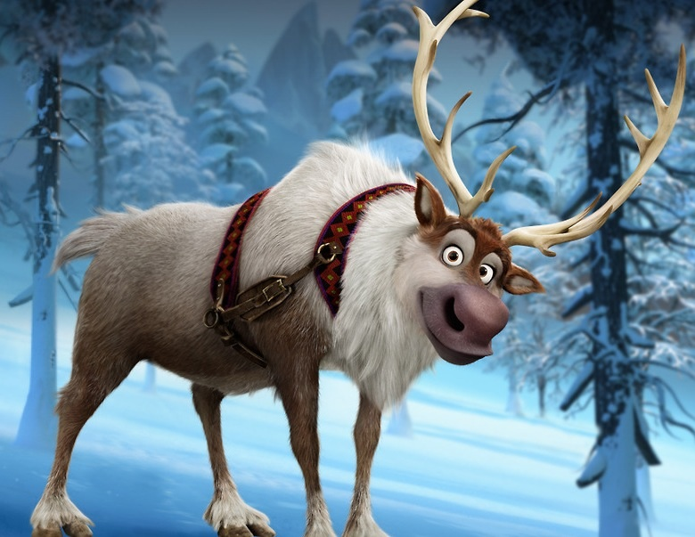
Sven the Reindeer the second most famous reindeer!

Slide 8
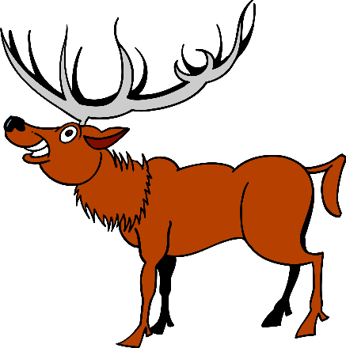
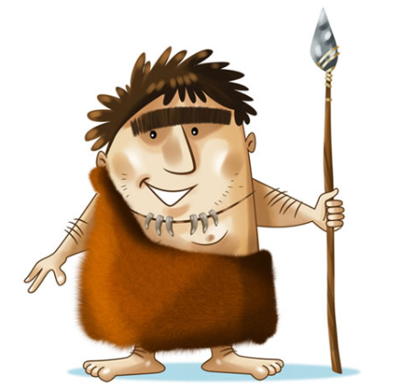
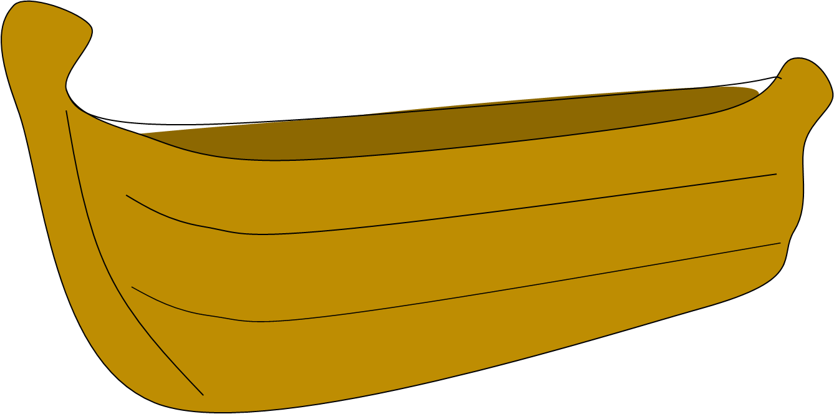
An Fia Rua
5000 years ago
Our Neolithic ancestors or Stone Age people
brought red deer to Ireland in boats around
5000 years ago.
They used deer for food and for clothing.

Slide 9
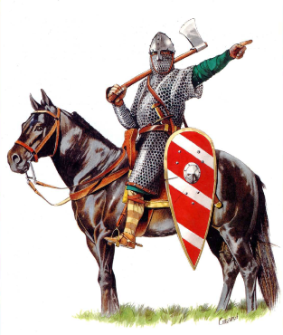
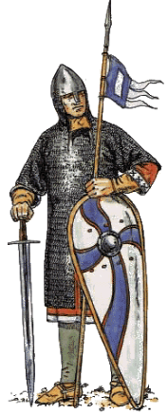
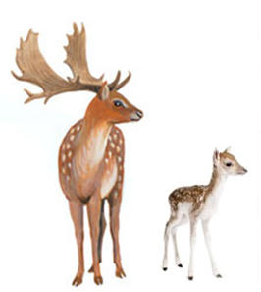
An Fia Bui
In the thirteenth century the
Anglo-Normans introduced the
Fallow deer to Ireland – 1244

Slide 10
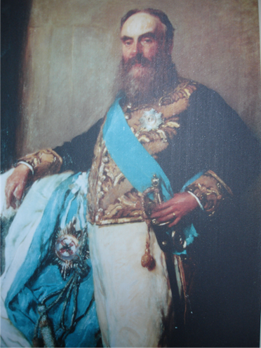
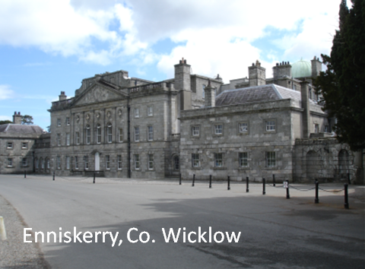
Lord Powerscourt
In 1860 brought Japanese Sika into Ireland.
He also brought in a lot of other animals….

Slide 11
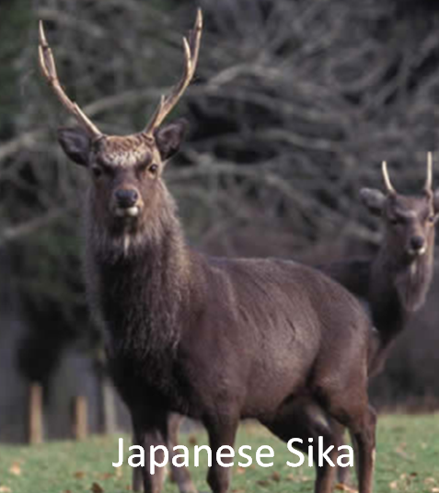
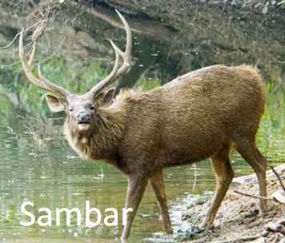
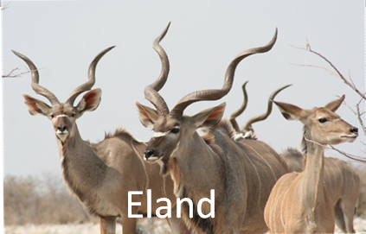
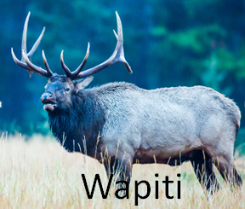
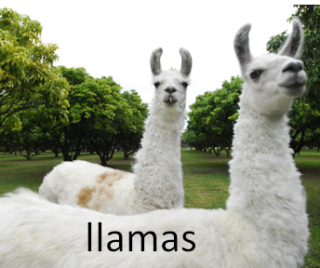
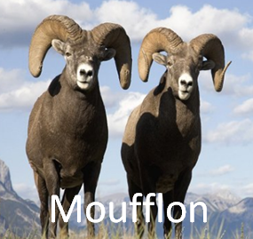
An Fia Seapánach

Slide 12
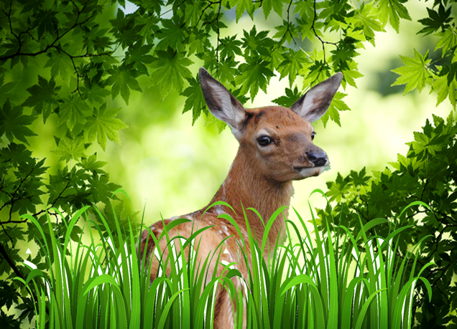
This is where
I live.

Slide 13
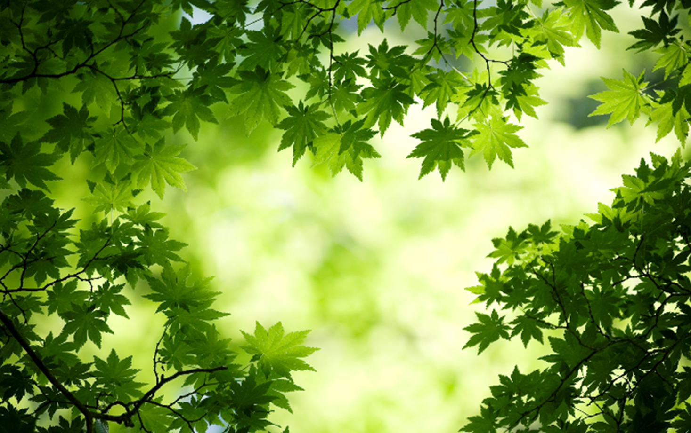
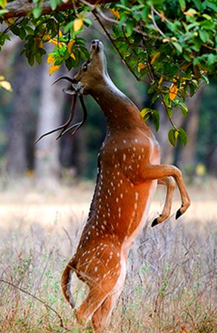
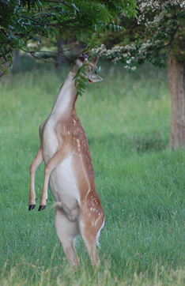
Deer eat grass and leaves.

Slide 14
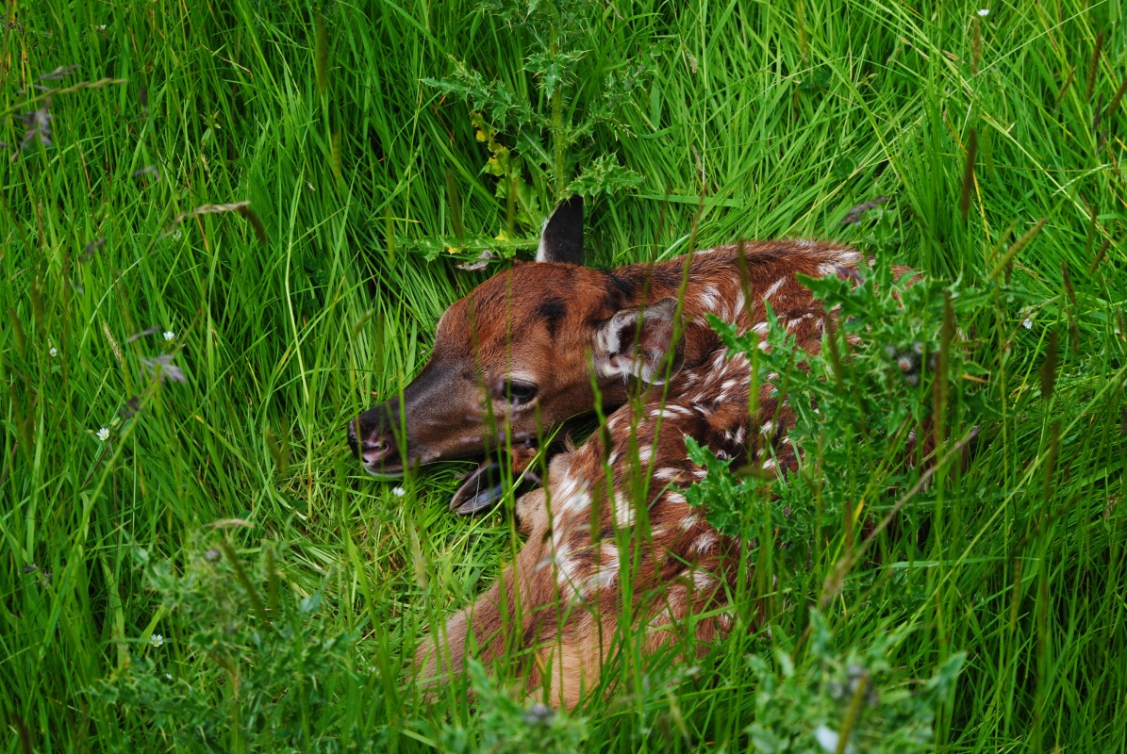
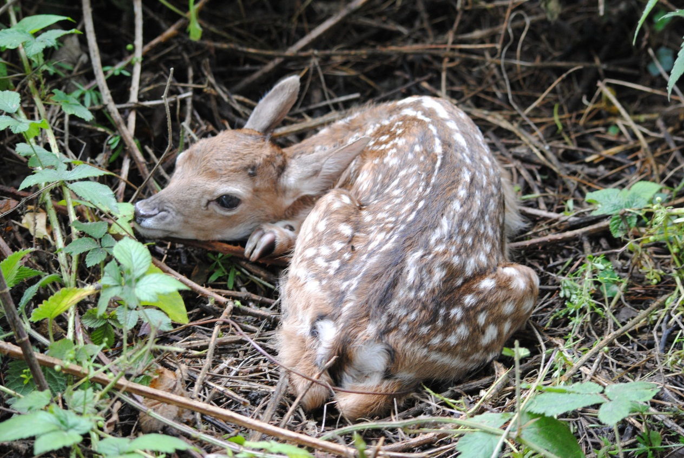
They are born in
May & June.
Baby deer are called calves and fawns.

Slide 15
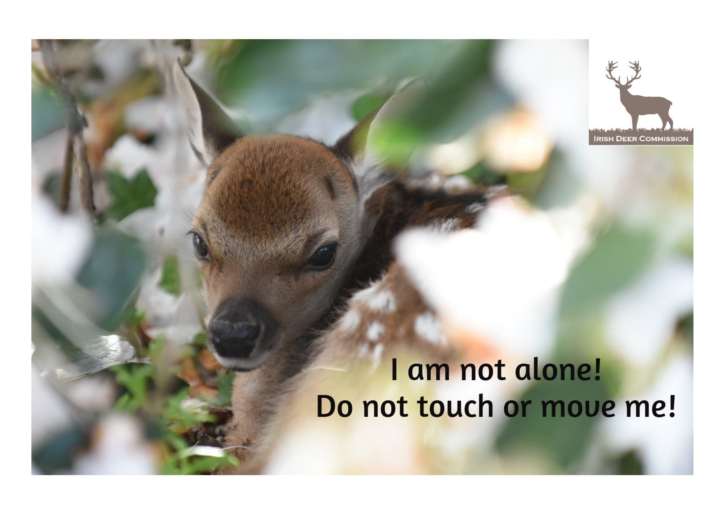

Slide 16
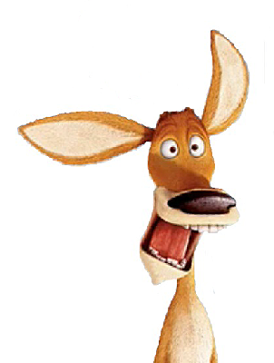
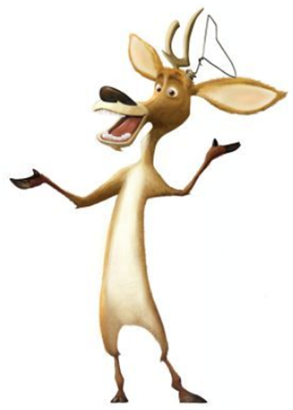
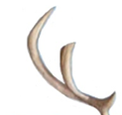
But the antlers grow back even larger the following year.
Deer antlers fall off every year.

Slide 17
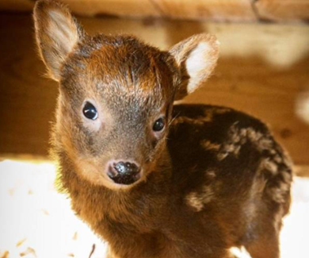
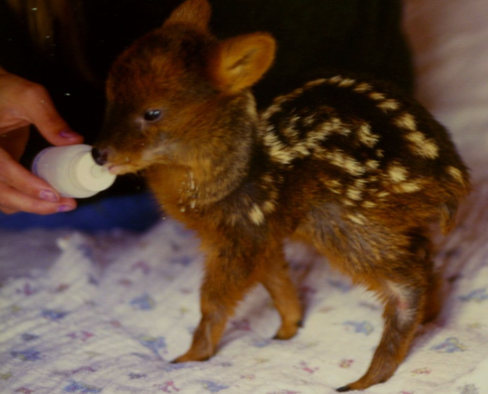
the world's smallest deer
The northern pudú range in size from 32 to 44 centimetres (13 to 17 in) tall. 3.3 to 6 kg

Slide 18
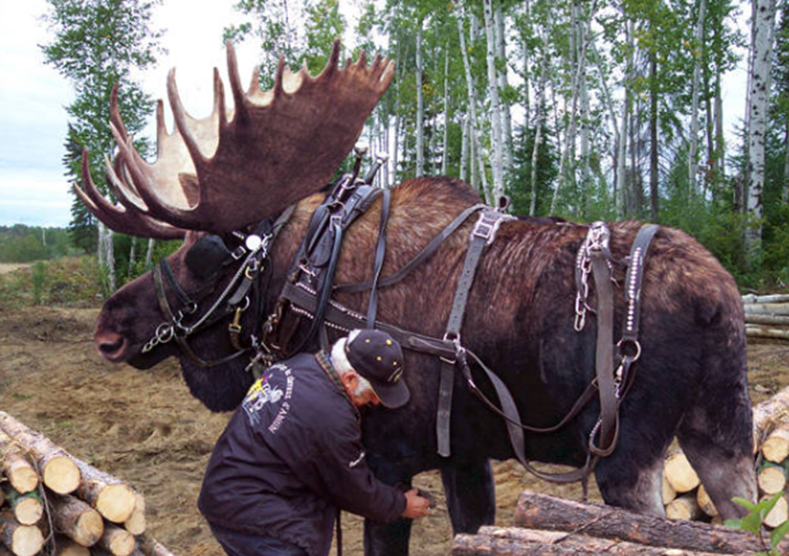
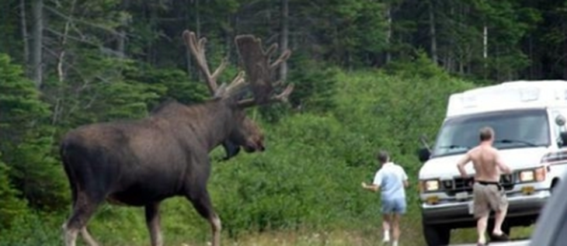
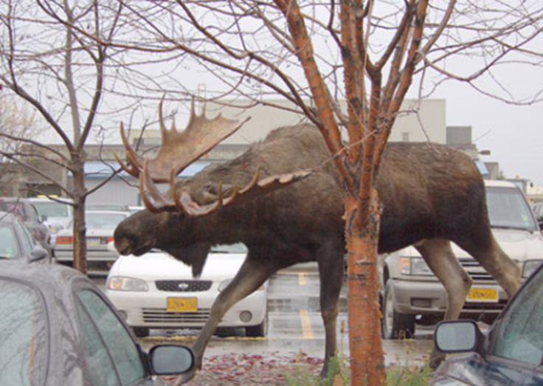
the largest deer in the world an adult moose stands 2.1 m (nearly 7 ft.) high at the shoulder, males can weigh up to 700 kg

Slide 19
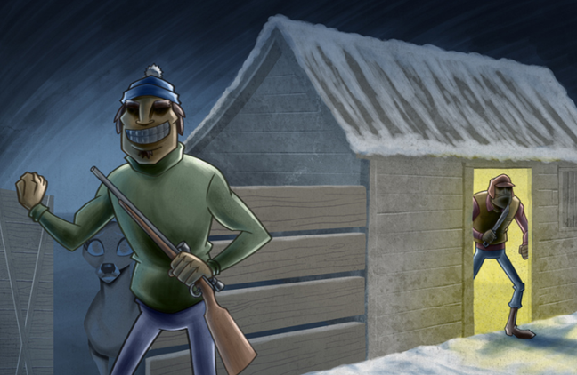
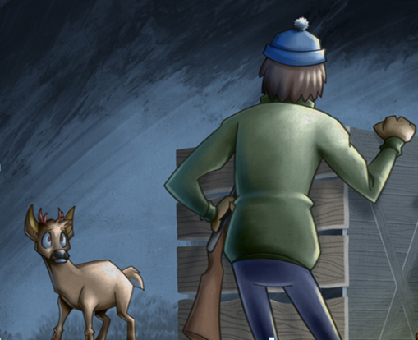
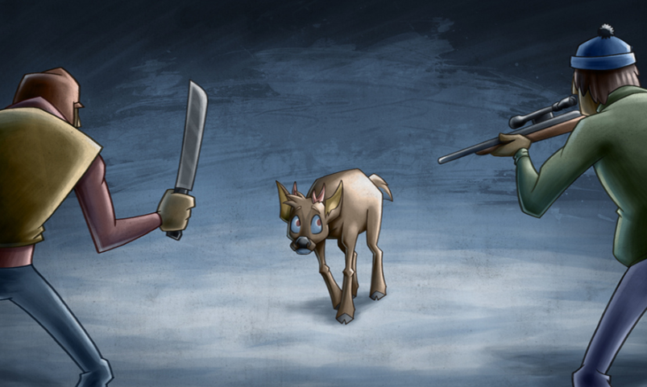
Poachers are going out at night shooting deer and selling them.
They are breaking the law.

Slide 20
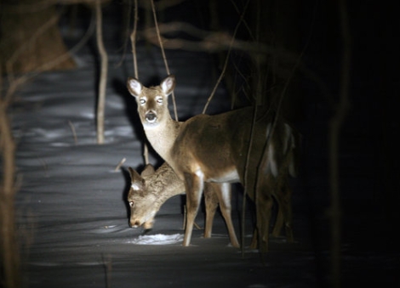
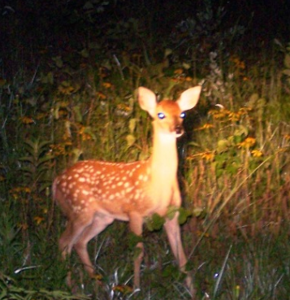
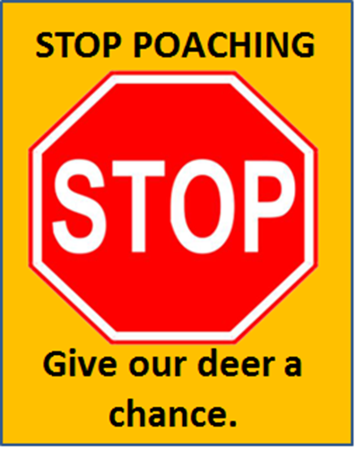
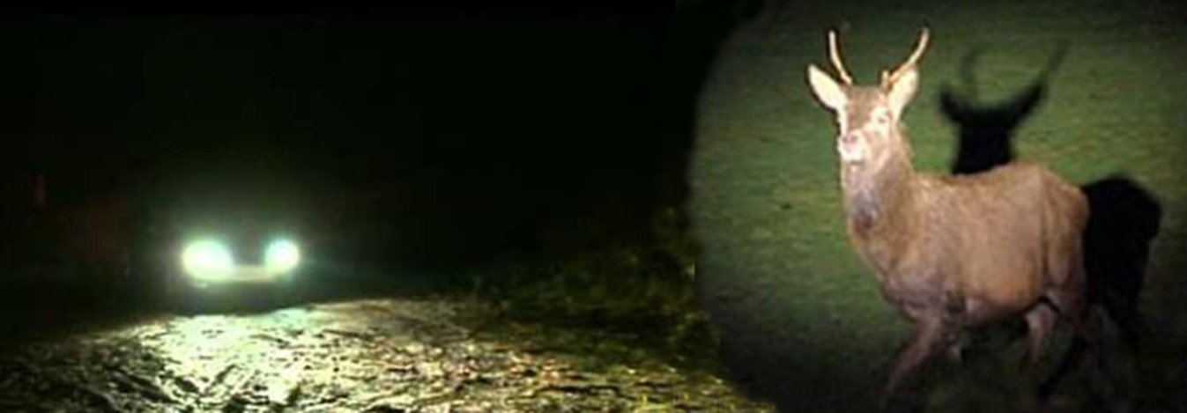

Slide 21










WE ARE WATCHING

Slide 22


Slide 23





Some deer grow tusks instead of antlers

Slide 24


I bet they can’t see me now…..

Slide 25

On behalf of the deer, thank you.

Slide 26


Photography thanks to Joe Murphy, Peter O’Toole, Siobhan English, Peter Gormley
Need to learn more? Visit www.irishdeercommission.ie or email us on info@irishdeercommission.ie
Also find us on

